Slide 1
18.404/6.840 Intro to the Theory of Computation
Instructor: Mike Sipser
TAs: - Fadi Atieh, Damian Barabonkov, - Alex Dimitrakakis, Thomas Xiong, - Abbas Zeitoun, and Emily Liu
1

Slide 2
18.404 Course Outline
Computability Theory 1930s – 1950s
What is computable… or not?
Examples: program verification, mathematical truth
Models of Computation: Finite automata, Turing machines, …
Complexity Theory 1960s – present
What is computable in practice?
Example: factoring problem
P versus NP problem
Measures of complexity: Time and Space
Models: Probabilistic and Interactive computation
2

Slide 3
Course Mechanics
Zoom Lectures
Live and Interactive via Chat
Live lectures are recorded for later viewing
Zoom Recitations
Not recorded
Two convert to in-person
Review concepts and more examples
Optional unless you are having difficulty Participation can raise low grades
Attend any recitation
Text
Introduction to the Theory of Computation Sipser, 3rd Edition US. (Other editions ok but are missing some Exercises and Problems).
Homework bi-weekly – 35%
More information to follow
Midterm (15%) and Final exam (25%)
Open book and notes
Check-in quizzes for credit – 25%
Distinct Live and Recorded versions
Complete either one for credit within 48 hours
Initially ungraded; full credit for participation
3

Slide 4
Course Expectations
Prerequisites
Prior substantial experience and comfort with mathematical concepts, theorems, and proofs. Creativity will be needed for psets and exams.
Collaboration policy on homework
Allowed. But try problems yourself first.
Write up your own solutions.
No bibles or online materials.
4

Slide 5
Role of Theory in Computer Science
Applications
Basic Research
Connections to other fields
What is the nature of computation?
5

Slide 6






Let’s begin: Finite Automata
0
1
$$M1$$
0,1
1
$$q3$$
$$q1$$
$$q2$$
0
Input: finite string Output: Accept or Reject
Computation process: Begin at start state, read input symbols, follow corresponding transitions, Accept if end with accept state, Reject if not.
Examples: 01101 → Accept 00101 → Reject
$M1$ accepts exactly those strings in $A$ where $A = \{w| w$contains substring $11\}.$
States: $q1 q2 q3$
Transitions:
Start state:
Accept states:
1
Say that $A$ is the language of $M1$ and that $M1$ recognizes $A$ and that $A = L(M1)$.
6

Slide 7











Finite Automata – Formal Definition
Defn: A finite automaton $M$ is a 5-tuple $(Q, Σ, δ, q0, F)$
$Q$ finite set of states
$Σ$ finite set of alphabet symbols
$δ$ transition function $δ: Q×Σ → Q$
$q0$ start state
$F$ set of accept states
Example:
$δ (q, a) = r$ means
$$q$$
a
$$r$$
0
$$M1$$
1
0,1
$$q1$$
$$q2$$
1
$$q3$$
0
$M1 = (Q, Σ, δ, q1, F)$
$Q = \{q1, q2, q3\}$
$Σ = \{0, 1\}$
$F = \{q3\}$
$$δ=$$
 | 0 | 1
$$q1$$ | $$q1$$ | $$q2$$
$$q2$$ | $$q1$$ | $$q3$$
$$q3$$ | $$q3$$ | $$q3$$
7
Notes:
Goal- Precise mathematical description

Slide 8


Finite Automata – Computation
Strings and languages
A string is a finite sequence of symbols in $Σ$
A language is a set of strings (finite or infinite)
The empty string ε is the string of length 0
The empty language $ø$ is the set with no strings
Defn: $M$ accepts string $w = w1w2 … wn$each $wi ε Σ$ if there is a sequence of states $r0, r1, r2, ,…, rn ε Q$ where: - $r0 = q0$ - $ri = δ(r_{i−1}, wi)$ for $1≤i≤n$ - $rn ε F$
Recognizing languages
$L(M) = \{w| M accepts w\}$
$L(M)$is the language of $M$
$M$ recognizes $L(M)$
Defn: A language is regular if some finite automaton recognizes it.
8

Slide 9






Regular Languages – Examples
$$M1$$
0
1
0,1
1
$$q3$$
$$q1$$
$$q2$$
0
More examples:
Let $B=\left\{w\right| w$has an even number of 1s$\}$ $B$ is regular (make automaton for practice).
Let $C=\left\{w\right| w$has equal numbers of 0s and 1s$\}$ $C$ is not regular (we will prove).
$L\left(M_{1}\right)= \{w| w contains substring 11\}=A$
Therefore $A$ is regular
Goal: Understand the regular languages
9

Slide 10


Regular Expressions
Regular operations. Let $A,B$ be languages:
Union: $A∪B=\left\{w\right| w∈A$ or $w∈B\}$
Concatenation: $A∘B=\left\{xy\right| x∈A$ and $y∈B\}=AB$
Star: $A^{∗}=\left\{x_{1}… x_{k}\right|$each$x_{i}∈A$ for $k≥0\}$ Note: $ε∈A^{∗}$ always
Example. Let $A=\{$good, bad$\}$ and $B=\{$boy, girl$\}$.
$A∪B=${good, bad, boy, girl}
$A∘B=AB=$ {goodboy, goodgirl, badboy, badgirl}
$A^{∗}=$ {$ε$, good, bad, goodgood, goodbad, badgood, badbad, goodgoodgood, goodgoodbad, … }
Regular expressions
Built from $Σ$, members $Σ, ∅,ε$ [Atomic]
By using $∪, ∘, ∗$ [Composite]
Examples:
${\left(0∪1\right)}^{∗}=Σ^{∗}$ gives all strings over $Σ$
$Σ^{∗}1$ gives all strings that end with 1
$Σ^{∗}11Σ^{∗}=$all strings that contain 11 $=L\left(M_{1}\right)$
Goal: Show finite automata equivalent to regular expressions
10

Slide 11




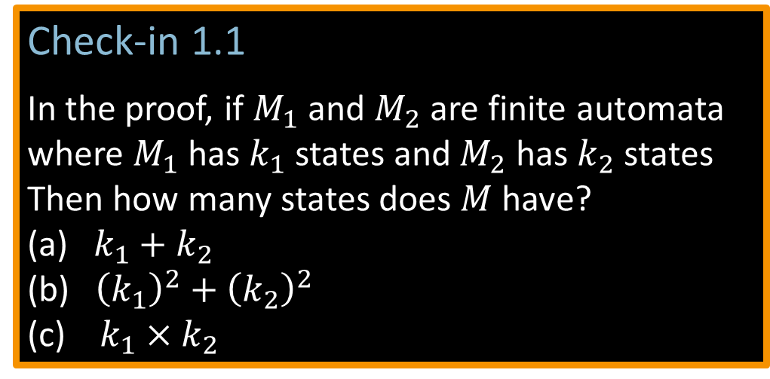




Closure Properties for Regular Languages
Theorem: If ${ A}_{1}, A_{2}$are regular languages, so is $A_{1}∪A_{2}$ (closure under $∪$)
Proof: Let $M_{1}=(Q_{1}, Σ, { δ}_{1}, { q}_{1}, { F}_{1})$ recognize $A_{1}$ $M_{2}=(Q_{2}, Σ, { δ}_{2}, { q}_{2}, { F}_{2})$ recognize $A_{2}$
Construct $M = (Q, Σ, δ, q0, F)$ recognizing ${A_{1}∪A}_{2}$ $M$ should accept input $w$ if either $M_{1}$ or $M_{2}$ accept $w$.
Check-in 1.1
In the proof, if $M_{1}$ and $M_{2}$ are finite automata where $M_{1}$ has $k_{1}$ states and $M_{2}$ has$k_{2}$ states
Then how many states does $M$have?
(a) $k_{1}+k_{2}$
(b) ${\left(k_{1}\right)}^{2}+{\left(k_{2}\right)}^{2}$
(c) $k_{1}×k_{2}$
Components of $M$:
$Q=Q_{1}×Q_{2}$ $=\left\{\left(q_{1},q_{2}\right)\right|q_{1}∈Q_{1}$ and $q_{2}∈Q_{2}\}$
$q_{0}=(q_{1}, q_{2})$
$δ\left(\left(q,r\right),a\right)=\left(δ_{1}\left(q,a\right),δ_{2}\left(r,a\right)\right)$
$F=F_{1}×F_{2}$
$F=\left(F_{1}×Q_{2}\right)∪\left(Q_{1}×F_{2}\right)$
$$M_{1}$$
$$q$$
$$M$$
?
$$q,r$$
$$M_{2}$$
NO! [gives intersection]
$$r$$
11
Check-in 1.1

Slide 12



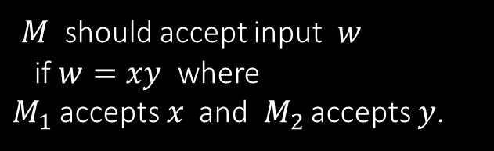





Closure Properties continued
Theorem: If ${ A}_{1}, A_{2}$are regular languages, so is $A_{1}A_{2}$ (closure under $∘$)
Proof: Let $M_{1}=(Q_{1}, Σ, { δ}_{1}, { q}_{1}, { F}_{1})$ recognize $A_{1}$ $M_{2}=(Q_{2}, Σ, { δ}_{2}, { q}_{2}, { F}_{2})$ recognize $A_{2}$
Construct $M = (Q, Σ, δ, q0, F)$ recognizing ${A_{1}A}_{2}$
$$M_{1}$$
$$M_{2}$$
$M$ should accept input $w$ if $w=xy$ where $M_{1}$ accepts $x$ and $M_{2}$ accepts $y$.
$$M$$
$$w$$
$$x$$
$$y$$
Doesn’t work: Where to split $w$?
12

Slide 13

Quick review of today
Introduction, outline, mechanics, expectations
Finite Automata, formal definition, regular languages
Regular Operations and Regular Expressions
Proved: Class of regular languages is closed under $∪$
Started: Closure under $∘$ , to be continued…
13

Slide 14
MIT OpenCourseWare
https://ocw.mit.edu
18.404J Theory of Computation
Fall 2020
For information about citing these materials or our Terms of Use, visit: https://ocw.mit.edu/terms.

